Slide 1
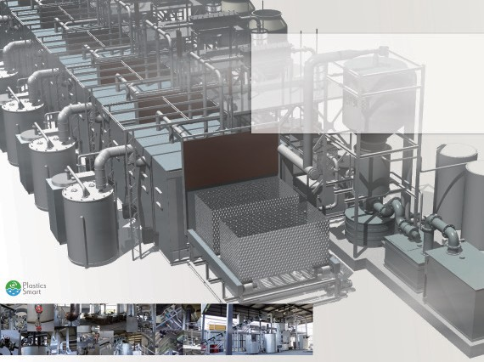


Superheated Steam Decomposition Fuel Recovery Unit
RENEWABLE ENERGY RECOVERY & CARBONIZATION PLANT
Resin-based mixed waste volume reduction and fuel recovery extraction unit " URBAN RIG" Proposal for Waste Oil Extraction Unit.
Volume reduction of resin-based mixed waste and recycled resource fuel extraction device "URBAGN RIG waste oil extrtaction system" Proposal
OneWorld corporation Zip:547-0016 Phone: +81-6-4392-7499 Mail: info@1-world.asia URL: www.1-world.asia
One world corporation headquarters /1-1-20 Nagayoshinagahara, Hirano-ku, Osaka-city, Japan.
Sea Waste Zero Award winning technology by Japan Ministry of the Environment
Copyright ONE WORLD + ART, All r ights reser ved.
1
LANGUAGE
英語 ^{ENGLISH}
Up date: 1. OCTOBER. 2019

Slide 2
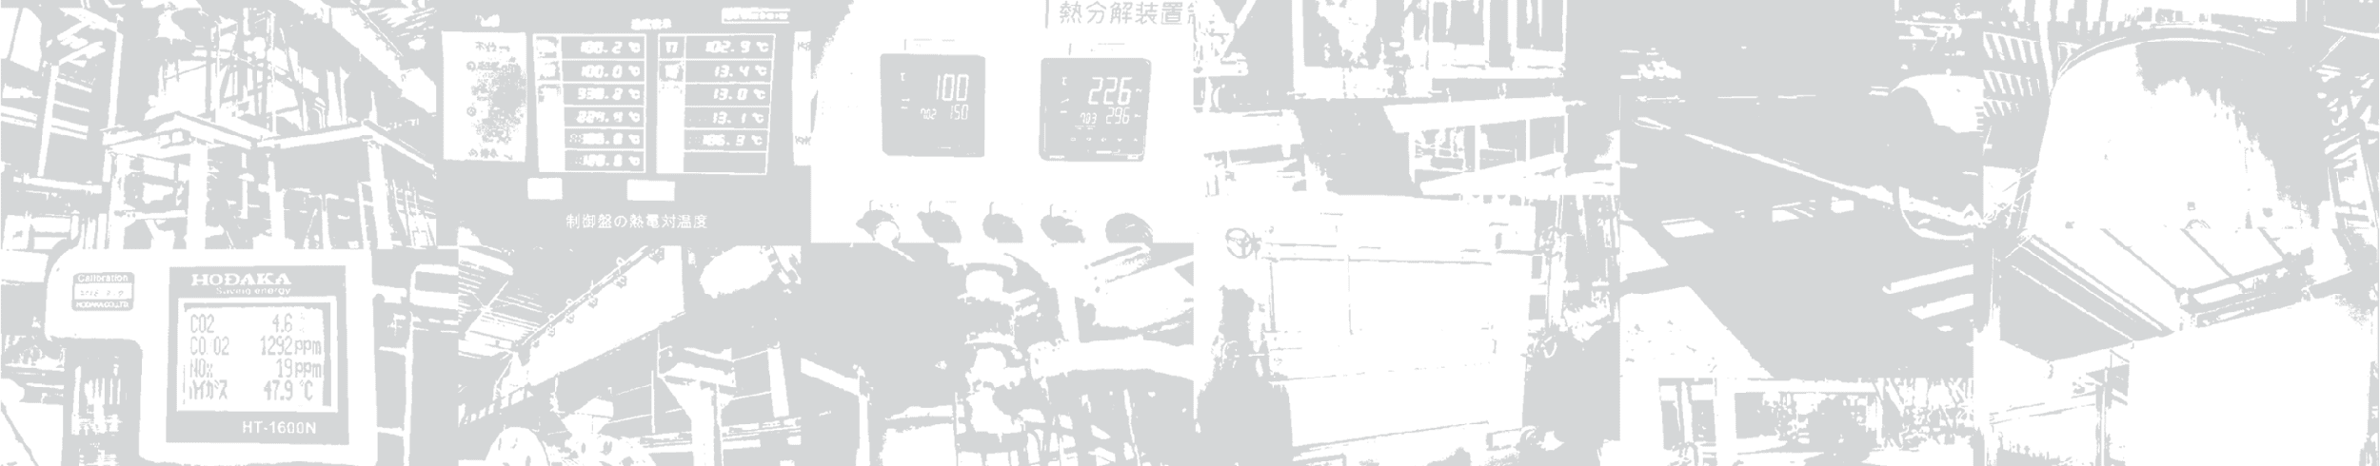
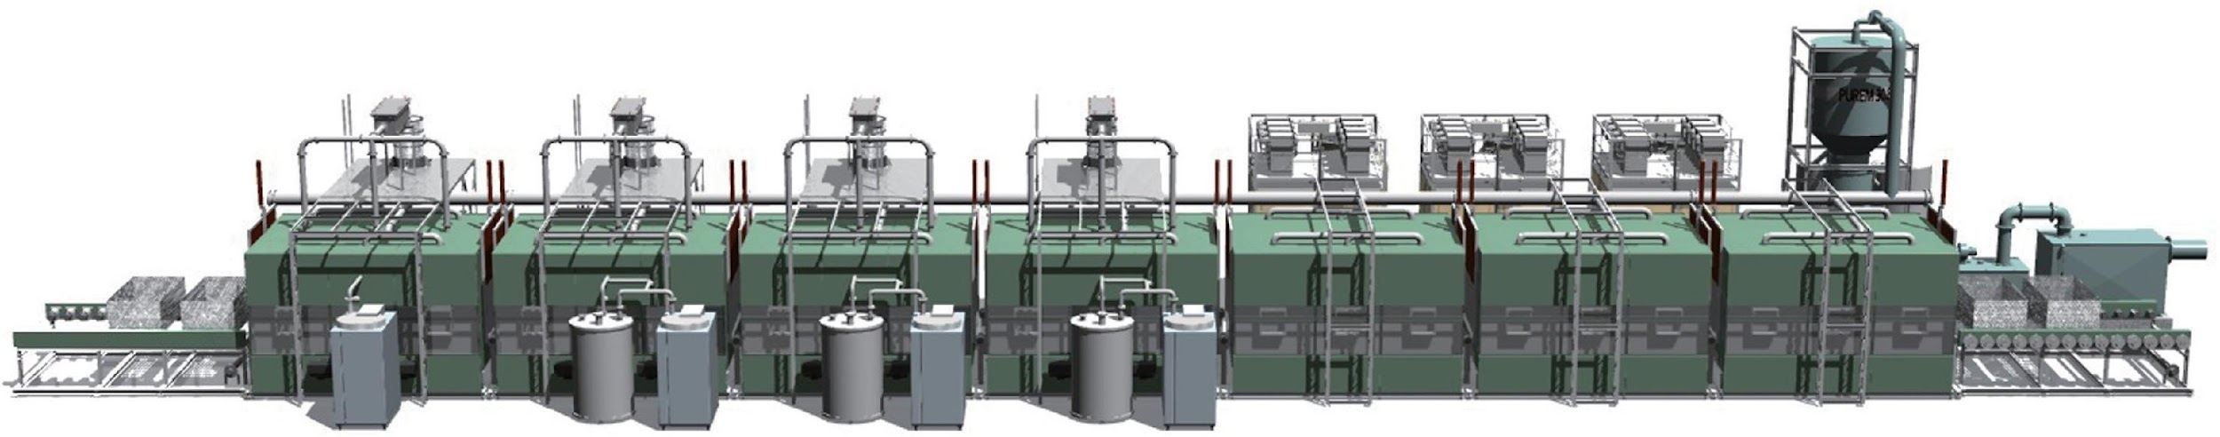
Secure high profitability with waste volume reduction. !!
－ Superheated Steam Decomposition Fuel Recovery Unit －
URBAN RIG
URBAN RIG makes inside the rector high temperature and oxygen free by superheated steam and recover the fuel oil from the resin-based mixed waste c/w food residue and mud.
The recovered fuel oil can be used as a fuel for natural renewable energy, and also a boiler fuel of the URBAN RIG and a superheated steam generator.
It is a waste treatment facility with high-level environmental and economic efficiency.
Image : URC-400 / Continuous type 40ton
_{II} No sorting required,
_{II} Solve the secondary pollution
_{II} Able to handle mixed PVC
_{II} Able to operate with
_{II} Pollution-free emission
Batch input processing.
issue with waste cleaning.
Waste plastic may contain mud and residue and non-resin materials of metals, and agricultural plastic waste may contain pesticides. This machine does not require clean such contami- nation and able to input after one-day storage to remove moisture.
and mixed resin
It is difficult to pelletize multicom- ponent materials such as crimped film and polyvinyl chloride resins. This facility is also able to extract high-quality oxygen-free recycled oil from PVC waste as well.
recycled oil
This facility uses gasified extracted oil as fuel for the boiler and super- heater. It is not necessary for fuel for operation except initial startup. It is expected highly profitable as only labor and electricity cost is the main operational costs.
function
The exhaust gas purification system per- forms high-level cleaning of the exhaust gas from steam boiler, superheaters, and temperature control heaters of decom- position furnaces. A portion of the puri- fied water purified by the system will be recycled and used by the steam boiler.
URBAN RIG does not require to sort waste for processing and able to vaporize and carbonize the waste by superheated super-fine particles steam. Furthermore, metals can be extracted in a non-oxidizing state.
Page 2
※ Copyright Oneworld Ccorprration. + ART, All r ights reser ved.

Slide 3
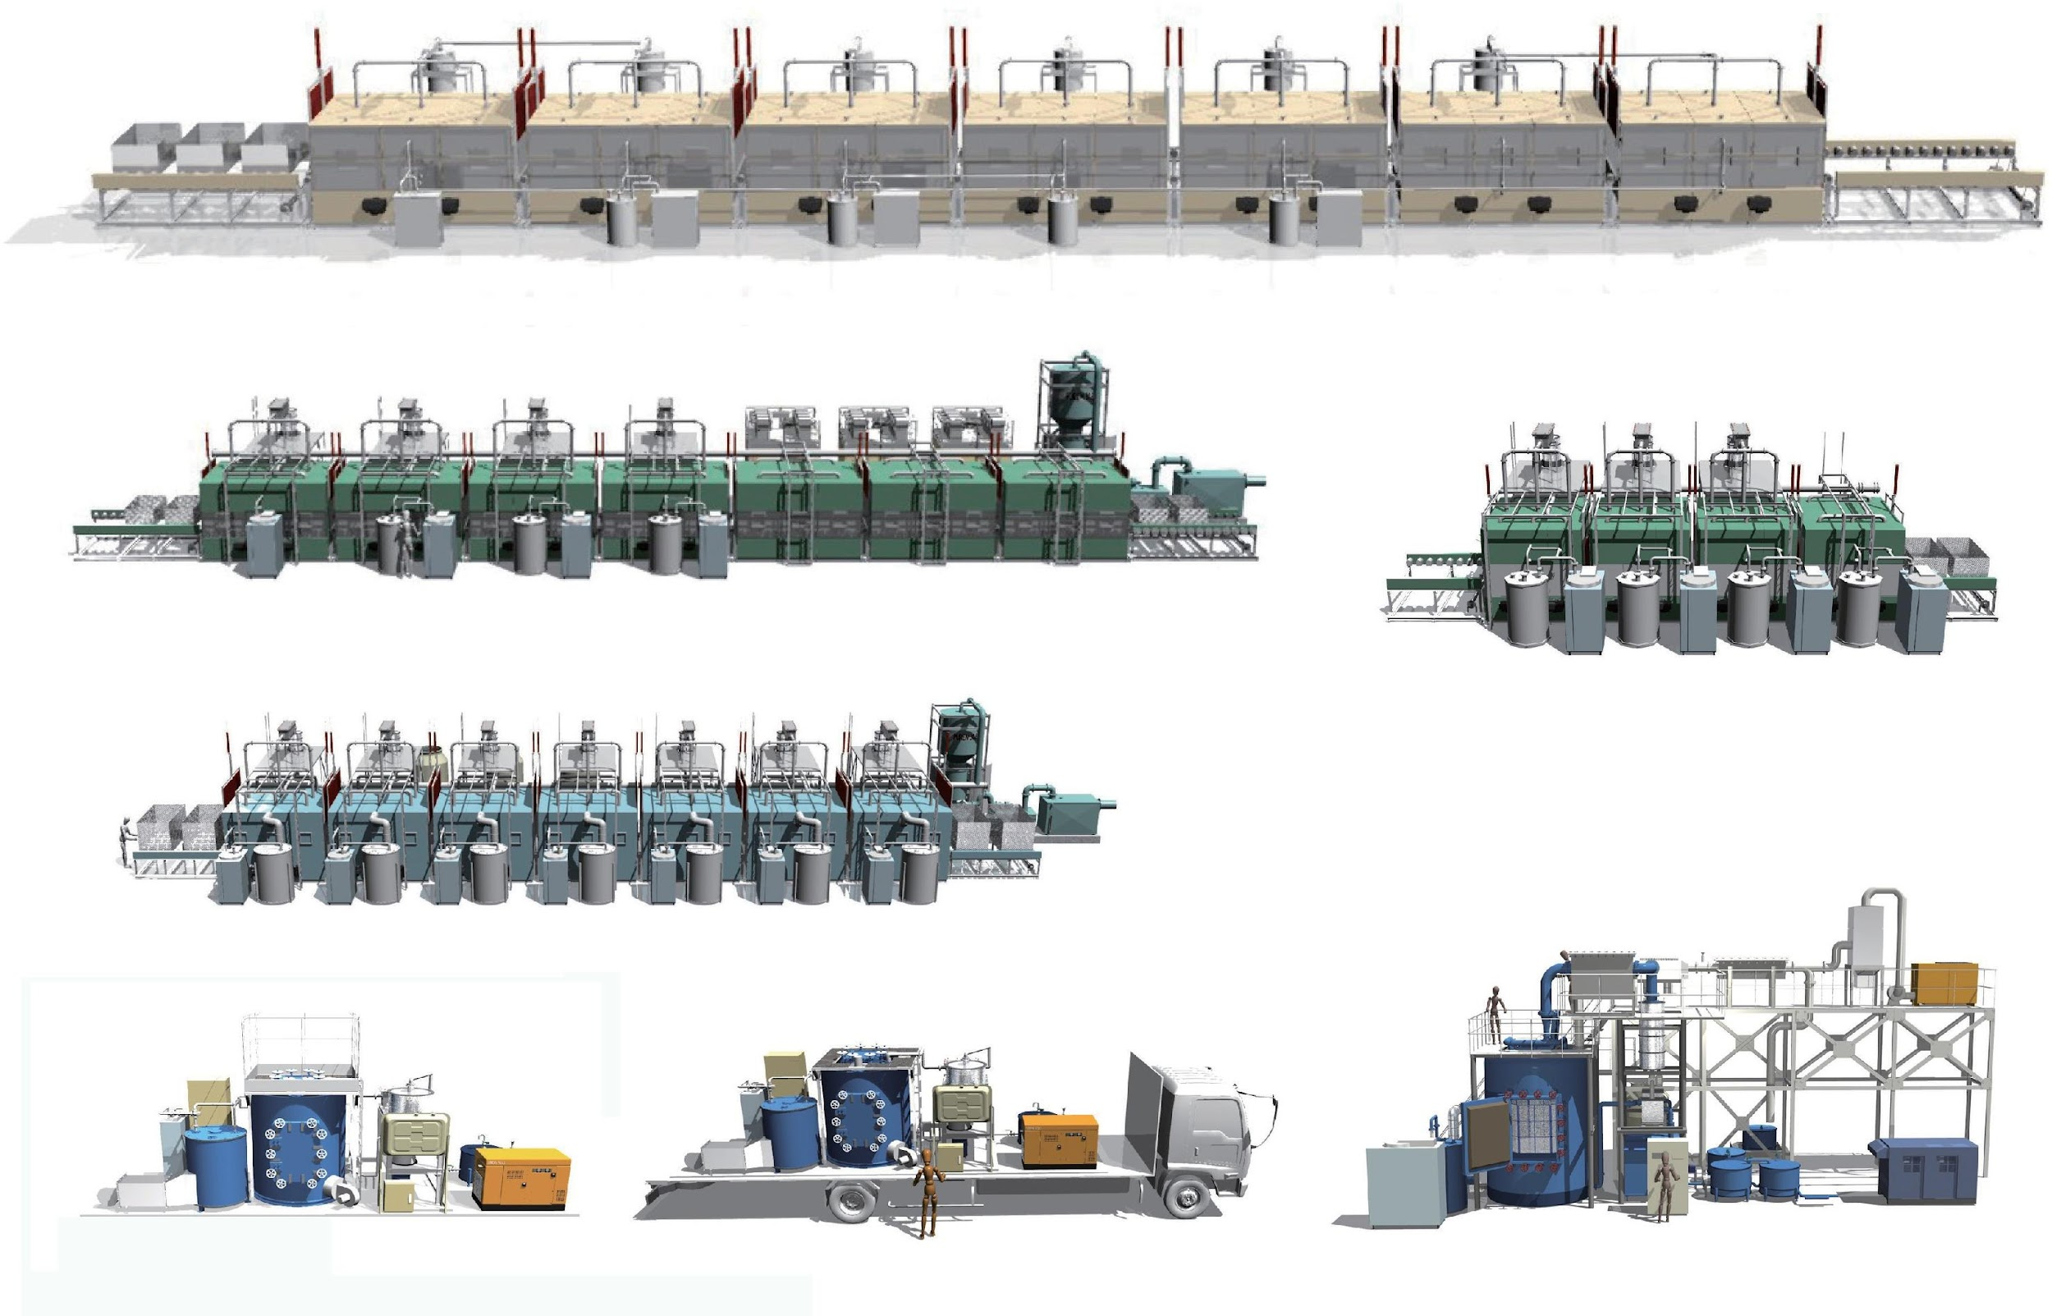
EXPLANATION
URBAN RIG Line-up
200 ton 7
Continuous Process
URC-2000
40 ton Process
URC-400
Continuous
100 ton Process
URC-1000
Continuous
_{40 ton} Continuous
Process
URC-400
1 ton 1 Batch
URB-10
1 ton 1 Batch
URT-10
5 ton 1 Batch
URB-50
1 Mt batch system Stationary Type
※ The facility image may be different from the real one. It is an image based on the ideal basic design Page 3

Slide 4
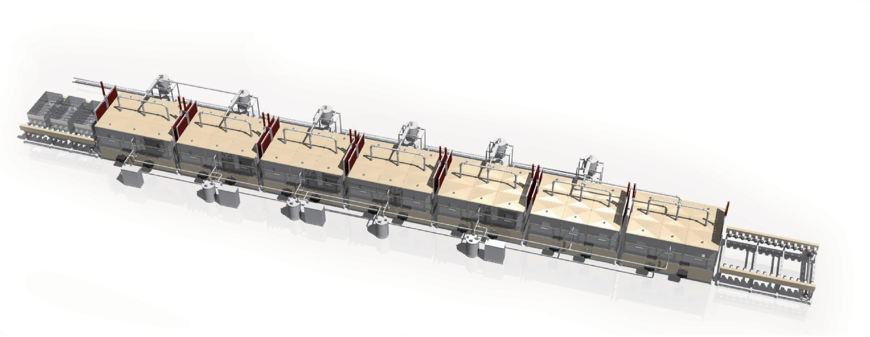






200 ton 7
Continuous Process
URC-2000 for General waste, volume reduction, and liquefied resource recovery
URC-2000 is designed for carbonizing waste with high moisture content such as food residue, waste with sludge and soil, etc., which is represented by general household waste. Input to the process, 3 buckets as 1 batch and automatically operated by microcomputer from the loading slot through 7 processes such as drying, heating, carbonization extraction, and cooling to the unloading slot.
^{SPEC}
URC-2000
Product model name URC-2000
Throughput / day 200 ton / day
Decomposition temperature MAX 600°normal, 0.2MPa under Size (Processing Unit) W:66m D: 7m H: 7m Size (bucket) W: 1.5m D: 3m H: 1m / 4.5m³
Process System Continuous type
Steam Generation Steam boiler
Superheating type Heating burner
Control System microcomputer control
Safety device Valve & sensor
GENERAL
META L
ORGANICS
99 m
18 m
Water storage tank
Water storage tank
Non-carbide
/ metal / glass storage area
Waste storage place volume: 6000 m3
Input throat ^{(for three days)} (with crushing function)
Oil tank (3P)
Building area
4,650 m²
Processing plant
3,000 m²
蓄電機
Exhaust gas purification Power generation room equipment (soundproof)
Waste storage
640 m²
45 m
Reclaimed storage area
810 m²
Input throat (with crushing function)
Office warehouse
200 m²
Sorting machine
Main building structure
Firewall structure
HR-construct
R-construct
Carbide and mixed solid fuel storage area
Ceiling height
10 m
URC-2000
Carbide and mixed solid fuel processing plant
Oil storage tank
5 t × 8
Water storage tank
5 t × 2
Page 4
※ Copyright Oneworld Ccorprration. + ART, All r ights reser ved.

Slide 5

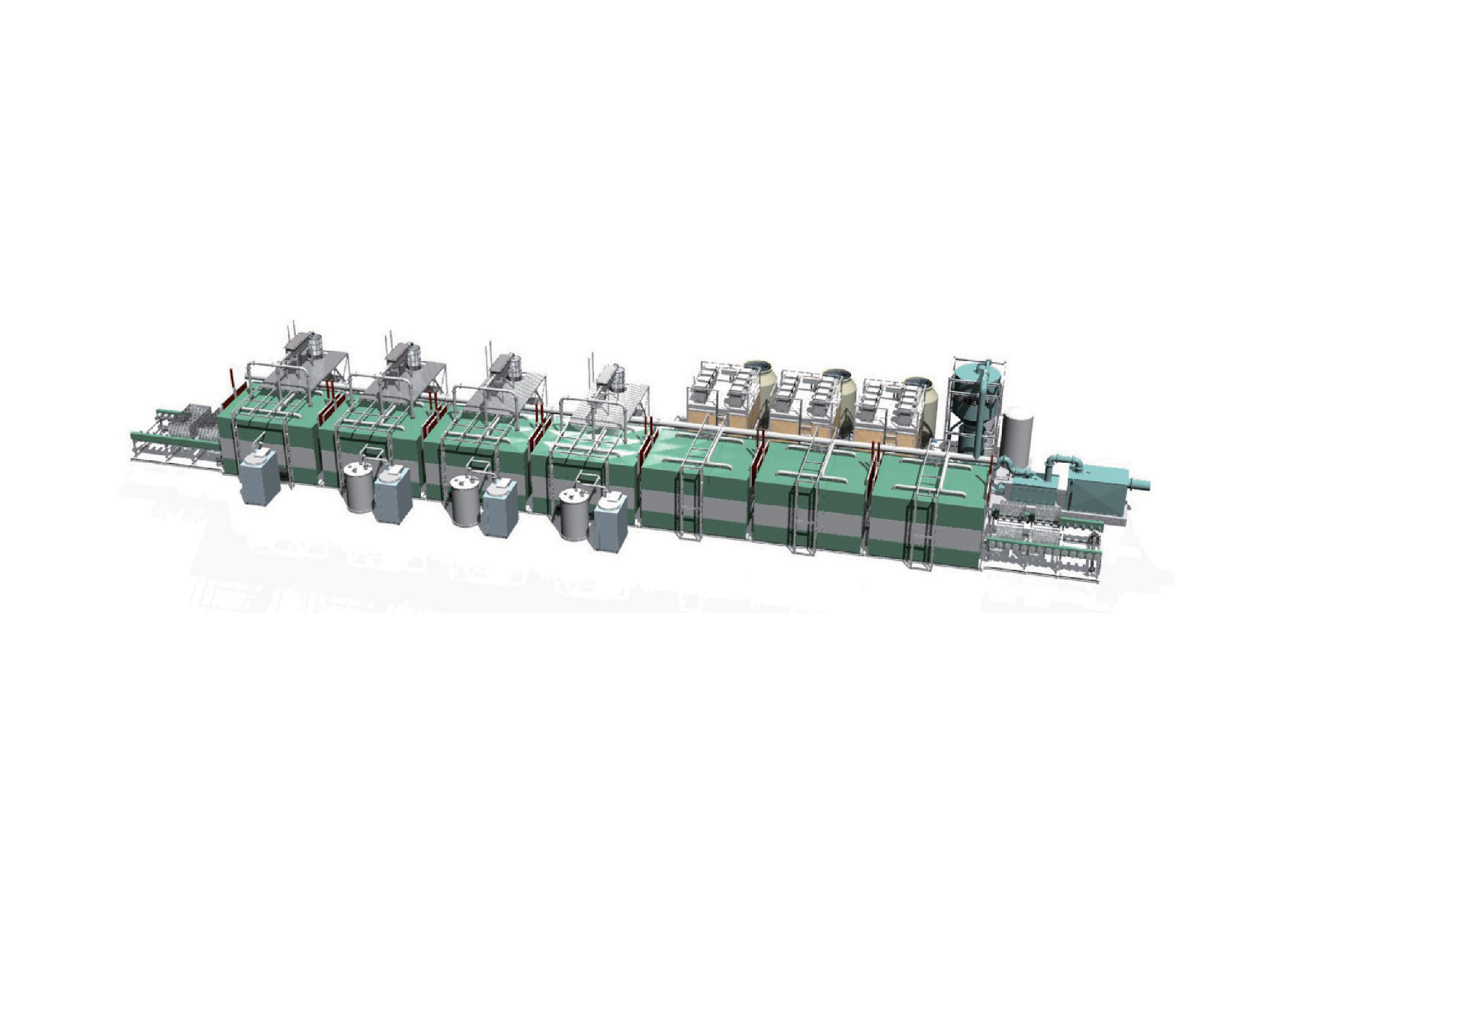
EXPLANATION
40 ton ^{Process}
URC-400 for Resin waste / Liquefaction resource recovery
URC-400 is designed dedicated for resin-based waste treatment (up to 40Mt/day) to extract liquefied recovery fuel. Input to the process as 3 buckets as 1 batch and operate seven processes. It is possible to process wastes with high thermal conduc- tivity, such as mixed waste plastic, electronic parts, synthetic leather, and vinyl, etc. th a t applicable for chemical recycling in a short time.
^{SPEC}
Continuous
Product model name
URC-400
URC-400
Throughput / day
40ton / day
Decomposition temperature
MAX 600°normal, 0.2MPa under
Size (Processing Unit)
W: 41m D: 7m H: 7m
GENERAL
META L
ORGANICS
Size (bucket)
W: 1m D: 1.5m H: 0.7m / 1m³
Process System
Continuous type
Steam Generation
Steam boiler
Superheating type
Heating burner
Control System
microcomputer control
Safety device
Valve & sensor
95 m
Water storage tank
Exhaust gas purification equipment
Carbide and mixed solid fuel processing plant
30 m
Waste storage place
Diesel oil
storage tank
Non-Carbide treatment area
Building area
2,700 m²
Unloading Area
Main building structure
Firewall structure
HR-construct
R-construct
Office
Changing room
Ceiling height
9 m
Oil storage tank
5 t × 8
Water storage tank
5 t × 2
※ The facility image may be different from the real one. It is an image based on the ideal basic design Page 5

Slide 6
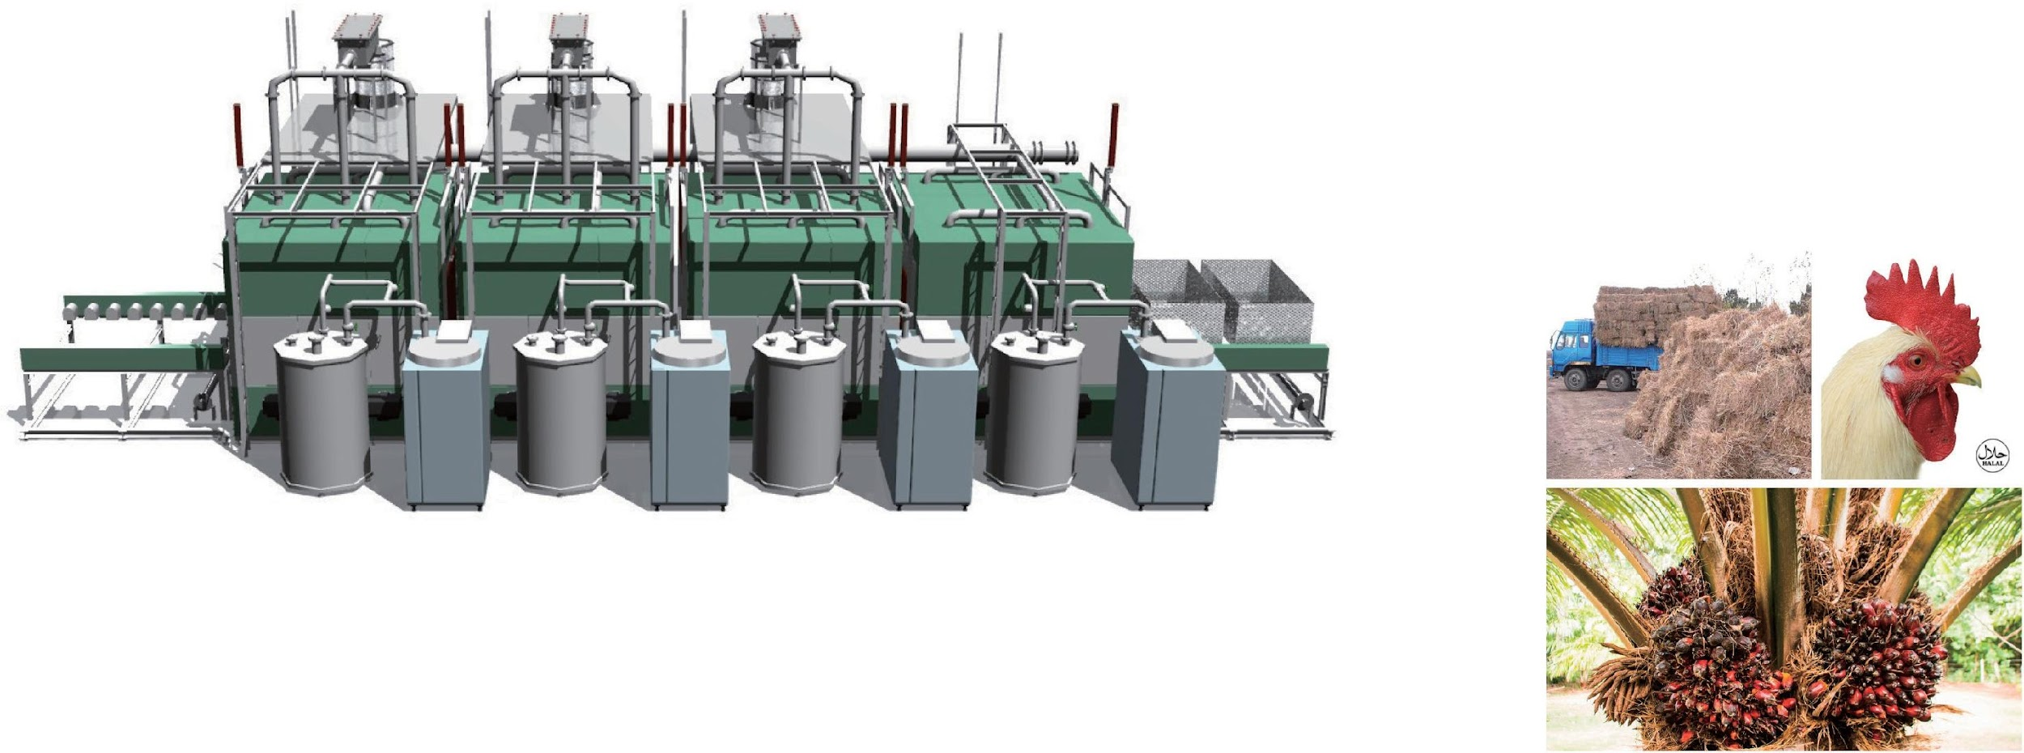


100 ton 4
Continuous Process
URC-1000 for General waste, volume reduction, and liquefied resource recovery
URC-1000 is designed for carbonizing waste with high moisture content such as food residue, waste with sludge and soil, etc., which is represented by general house- hold waste. Input to the process as 2 buckets as 1 batch and automatically operated by microcomputer from the loading slot through 4 processes such as drying, heat- ing, carbonization extraction, and cooling to the unloading slot.
^{SPEC}
URC-1000
Product model name
URC-1000
Throughput / day
100 ton / day
Decomposition temperature
MAX 600°normal, 0.2MPa under
Size (Processing Unit)
W:20m D: 7m H: 7m
GENERAL
ORGANICS
Size (bucket)
W: 1.5m D: 3m H: 1m / 4.5m³
Process System
Continuous type
Steam Generation
Steam boiler
Superheating type
Heating burner
Control System
microcomputer control
Safety device
Valve & sensor
20 m
68 m
Water storage tank
Exhaust gas purification equipment
Input throat (with crushing function)
Sorting machine
Carbide and mixed solid fuel storage area
Building area S
2
Waste storage place
35.5 m
2,415 m
- ditto - RS
710 m²
URC-1000
Main building structure
Firewall structure
HR-construct
R-construct
Input throat (with crushing function)
Carbide and mixed solid fuel processing plant
Ceiling height
9 m
Oil storage tank
5 t × 8
Water storage tank
5 t × 2
Page 6
※ Copyright Oneworld Ccorprration. + ART, All r ights reser ved.

Slide 7
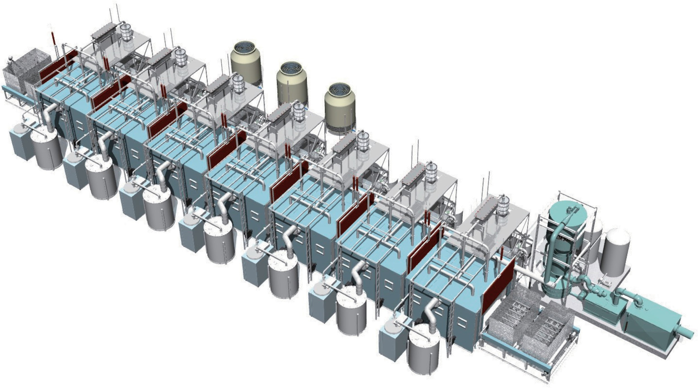




EXPLANATION
^{15 ton 7} Process
URC-150 for General waste, volume reduction, and liquefied resource recovery
URC-150 is designed for carbonizing waste with high moisture content such as food residue, waste with sludge and soil, etc., which is represented by general household waste. Input to the process as 1 or 2 buckets as 1 batch and automati- cally operated by microcomputer from the loading slot through 7 processes such as drying, heating, carbonization extraction, and cooling to the unloading slot.
※ One bucket set is for disposal of low specific gravity values such as waste plastic
^{SPEC}
Continuous
Product model name
URC-150
URC-150
Throughput / day
15 ton / day
Decomposition temperature
MAX 600°normal, 0.2MPa under
Size (Processing Unit)
W: 22m D: 6.5m H: 6m
Size (bucket 1P)
3
GENERAL
META L
ORGANICS
W: 1m D: 2m H: 1m / 1m
Size (bucket 2P)
W: 2m D: 2m H: 1m / 2m³
Process System
Continuous type
Steam Generation
Steam boiler
Superheating type
Heating burner
Control System
microcomputer control
Safety device
Valve & sensor
Water storage tank
Exhaust gas purification equipment
Generator
Oil storage tank
Waste storage place
Carbide and mixed solid fuel processing plant
Sorting machine
Input throat (with crushing function)
Building area S.
1,584 m²
- ditto - SR.
350 m²
Main building structure
Firewall structure
HR-construct
R-construct
Carbide and mixed solid fuel storage area
Ceiling height
8 m
Oil storage tank
３t ×３
Water storage tank
３t ×３
※ The facility image may be different from the real one. It is an image based on the ideal basic design Page 7

Slide 8
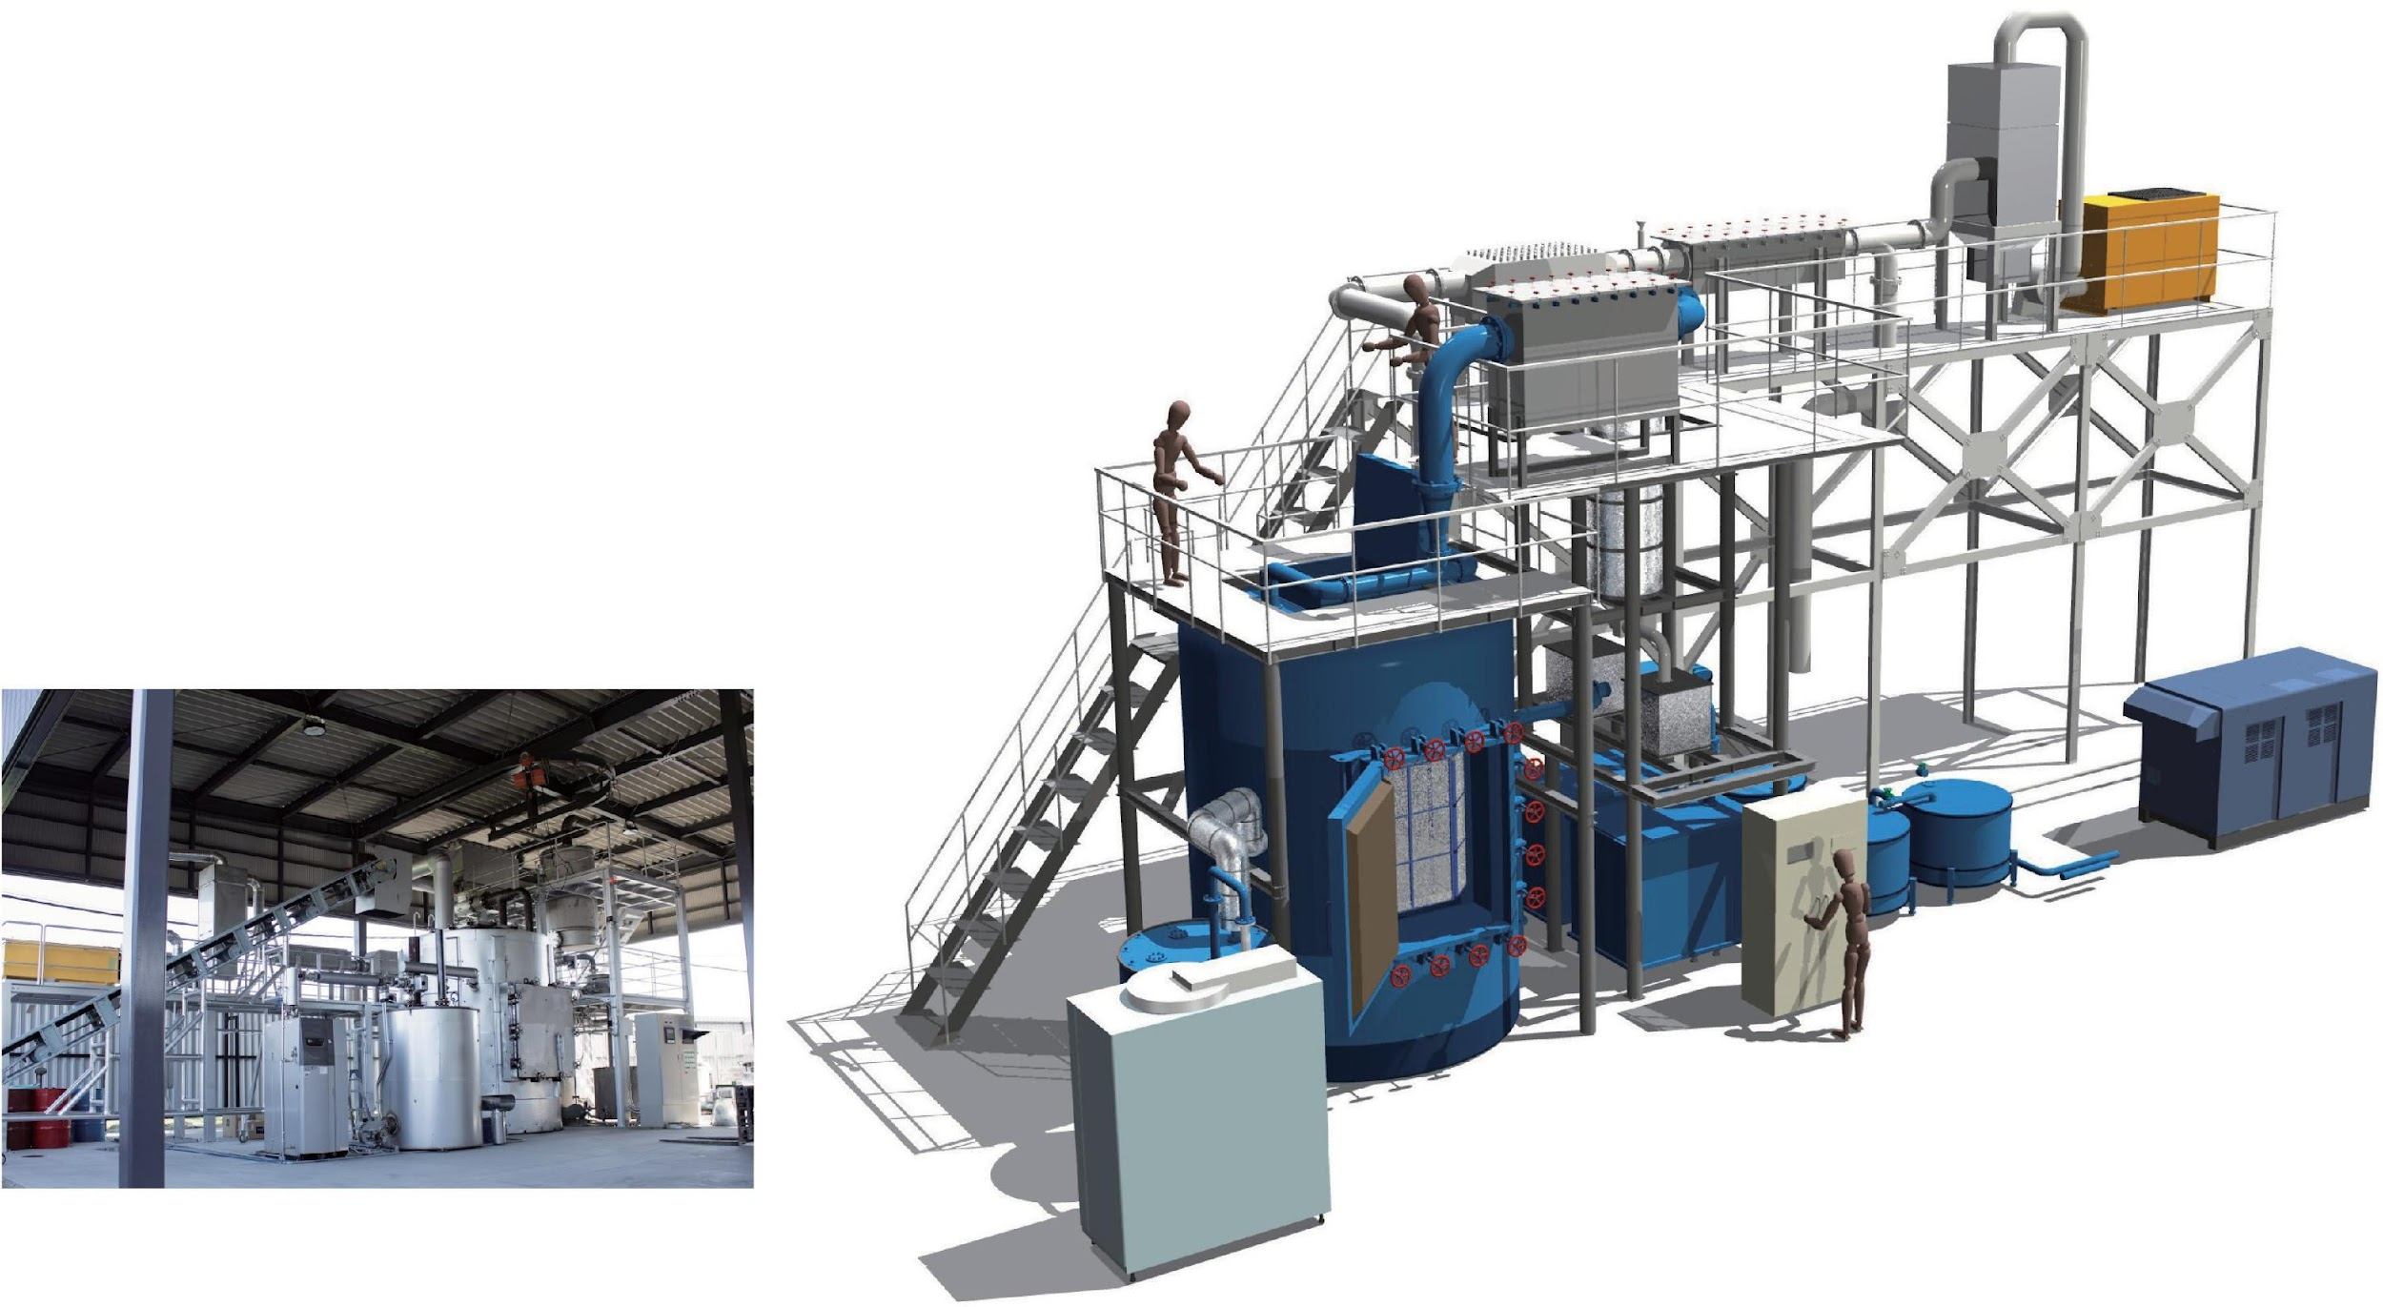



5 ton 1 Batch
URB-50
URB-50 for Resin waste / Liquefaction resource recovery
^{SPEC}
Product model name
URB-50
GENERAL
META L
ORGANICS
Type
Liquefaction resource recovery
Throughput / day
5 ton / day
Size
W:10m D:5m H:7m
Process System
Batch type
30 m
Waste storage place
Water storage tank
Site area and layout may differ by building regulation and disaster prevention laws and other rules. The input storage area needs a storage area according to the actual input plan.
Also, depending on the type of input, there may be cases where the relevant laws and regulations may require odor control and/or structural wall.
It is recommendable to take into account those issues for purchasing our facilities.
Water tank
Non-Carbide treatment area
Building area
620 m²
15 m
Hoist crane
Diesel oil storage tank
Main building structure
HR-construct
Firewall structure
R-construct
Carbide and mixed solid fuel processing plant
Ceiling height
8 m
Oil storage tank
5 t × 2
Water storage tank
5 t × 2
Page 8
※ Copyright Oneworld Ccorprration. + ART, All r ights reser ved.

Slide 9
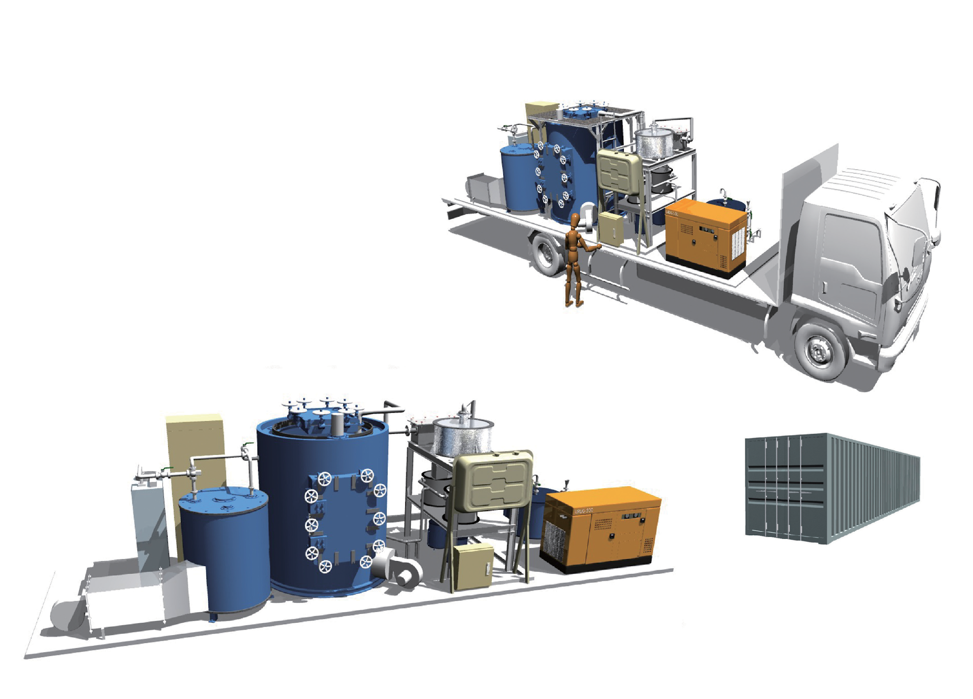
EXPLANATION
1 ton 1 Truck
URT-10
GENERAL ORGANICS
URT-10 for Mobile Waste Disposal Facility
^{SPEC}
Product model name
URT-10
Type
Mobile Plant
Throughput / day
1 ton / day
Size
W: 9 D: 2.5 H: 2.3
Process System
Batch type
Vehicle type
10 ton truck
1 ton 1 Batch
URB-10
URB-10 for Organic waste
Sterilization and volume reduction process
GENERAL
ORGANICS
2,591mm
(2,350mm)
12,192mm
(11,998mm)
2,438mm
(2,330mm)
※ (inner dimension)
We have secured a size that can be stored in a 40-foot marine container.
※ The facility image may be different from the real one. It is an image based on the ideal basic design Page 9

Slide 10
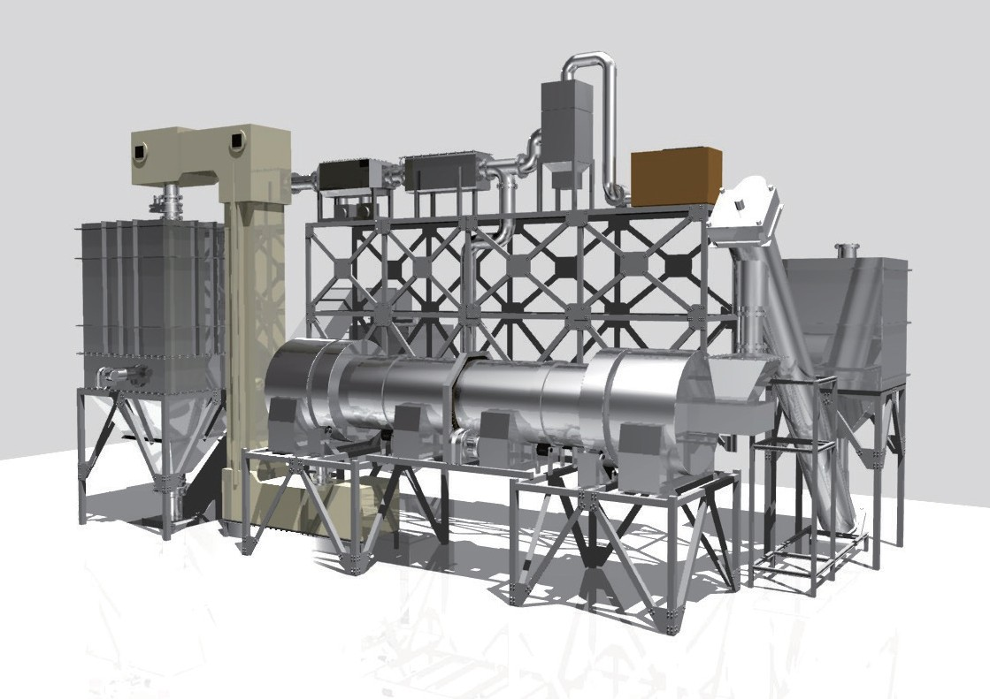



single machine use image
Page 10
※ Copyright Oneworld Ccorprration. + ART, All r ights reser ved.

Slide 11

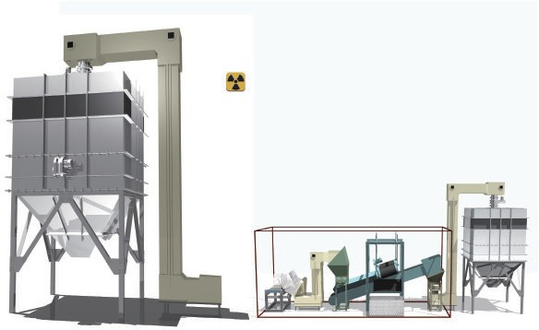
EXPLANATION
FORCE 9 / FIA CR-09 Far infrared catalytic reduction facility.
"Non-incinerated type, far infrared catalytic reduction facility" is made for the stabilization of carbide residue and the safe carbonization of toxic, hazardous waste produced by the URBAN RIG. It is a completely new patented technology to solve the problem of a conventional incinerator by detoxifing incinerated ash and carbide containing harmful substances and uses it as a recycled resource.
At conventional incinerator, heavy metals contained in incinerators have been converted to metal (oxides or chlorides) which are easily dissolved to water. With this new technology, those heavy metals are converted into sulfur compound (which is “non-water dissolved metal” ) by catalytic reduction and processing into a stable harmless metal by using a patented catalyst (ceramic) at a low temperature of about 400℃ . The treated waste can be used as a reclaimed resource for fertilizers, dehydrating agents, cleaning agents, soil conditioners, construction materials, etc.
Post-treatment measurement report of contaminated soil containing radioactive material
Test result
Sample : Radioactively contaminated soil.
Measurement : Radiation concentration of item γ-ray emitting nuclides.
Measurement : γ-ray spectrometry using method Ge semiconductor detector.
Test weight : 100g
Test date : January 22, 2013. Test time : 2,000 seconds.
Tested by : Sawahata Tadahiro.
Test Equipment: EG & G ORTEC GMX-40195-S
Nuclide name | Energy (keV) | Radiation concentration (Bq/g)
131 _{I *} | 364.5 | < 4.6 × 10⁻²
134 _{Cs} | 604.7 | 8.0 × 10⁰
137 _{Cs} | 661.6 | 1.6 × 10¹
※ Since no significant radioactivity was detected, the detection limit concentration is displayed.
Automatic insert type crushing sorting crusher.
Closed space for stabilization treatment of radioactivity
Rotary feeder
Bucket conveyor
Crusher
Belt conveyor / magnetic separator
Crusher
※ The facility image may be different from the real one. It is an image based on the ideal basic design Page 11

Slide 12
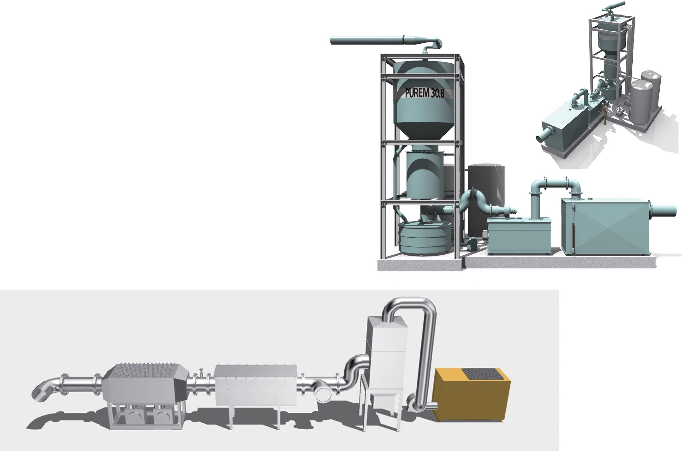













OPTION
PRIMO /Exhaust Gas Purification Facility
PRIMO is standard equipment installed at thermal power plants and oil/coal-burning petroleum facilities all over the world. It adopts the same principle as the NOx removal system which operates with ammonia mist shower. Desulfurizer for sulfur oxides sox (SOx) removal. PRIMO is dedicated for Urban Rig equipped with a deodorizer.
PRIMO type 6
Measurement point
DeNOx
NOx decomposition
SOx
400 0
3788 mg/m³
DeSOx
SOx decomposition
350 0
300 0
250 0
Dust
Dust removal
Reduced concentration
200 0
Measured concentration
150 0
1067 mg/m³
Deodo-
Odor removal
100 0
647 mg/m³
567 mg/m³
808 mg/m³
Measurement point
rizer
500
168 mg/m³
131 mg/m³
72 mg/m³
0
Measurement point
NOx
120
113 mg/m³
Measurement point
100
80
84 mg/m³
Reduced
concentration
60
49 mg/m³
Measured
concentration
40
33 mg/m³
20
11 mg/m³
9 mg/m³
0 mg/m³
0
appropriate machine
PRIMO type 4
PRIMO type 6
URC-2000•URC-1000 URC-400•URC-150
PRIMO type 4
URC-150•URB-50 URB-10•URT-10 FORCE 9
Cold air machine
Condenser
Scrubber
E P
Page 12
※ Copyright Oneworld Ccorprration. + ART, All r ights reser ved.

Slide 13
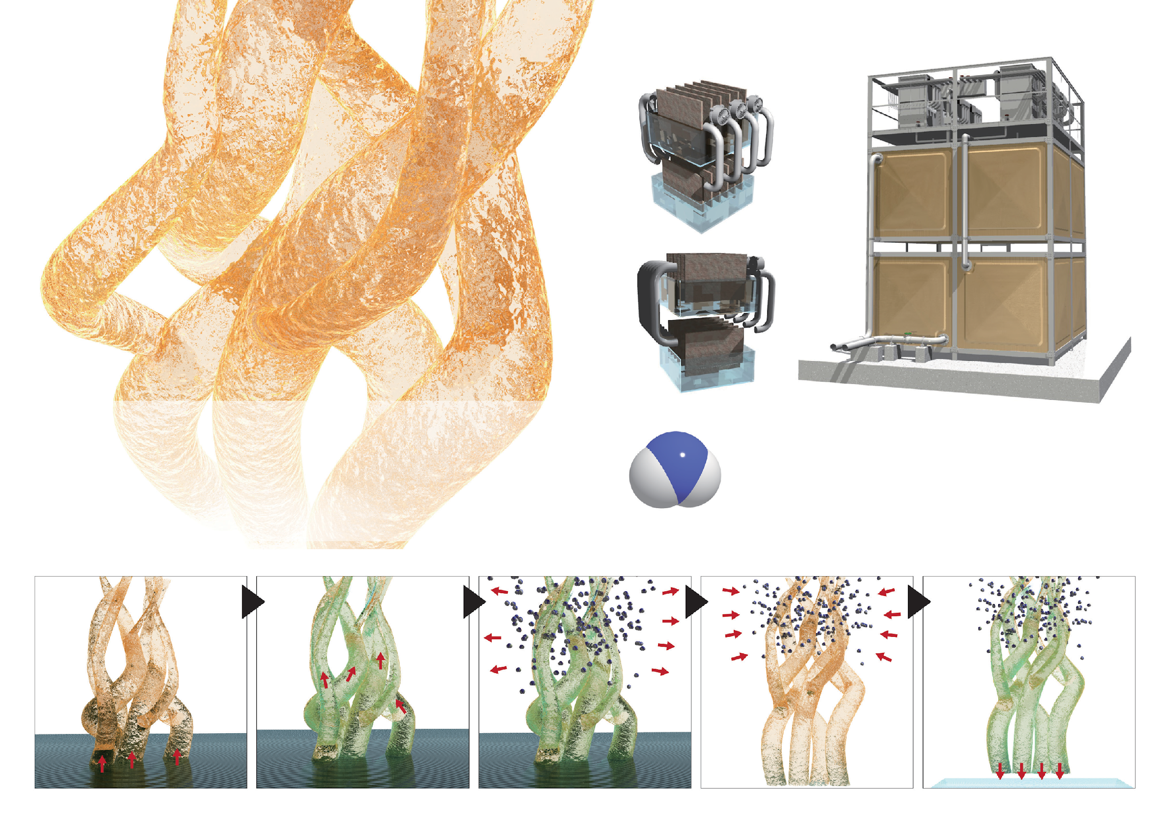
SEA CORAL
New Ceramic purification filter
EXPLANATION
OPTION
SEA CORAL / Specialized ceramic purifier
This technology is a water treatment system that uses the vaporization heat with special ceram- ic as an absorber. This SEA CORAL ceramic absorbs water molecule from wastewater. The water molecule is vaporized by air blowing and recover pure water from the saturated steam.
The “Sea Coral System” is a mechanism that extracts moisture from seawater or sludge water using a sea coral catalyst. Another sea coral catalyst adsorbs the water molecules to produce pure water completely free of minerals (in- cluding arsenic). To perform the process efficiently, generate vaporization heat by air blowing.
absorption of the solution
rise of the aqueous solution
release of water molecules
absorption of water molecules
discharge of water molecules
※ The facility image may be different from the real one. It is an image based on the ideal basic design Page 13

Slide 14
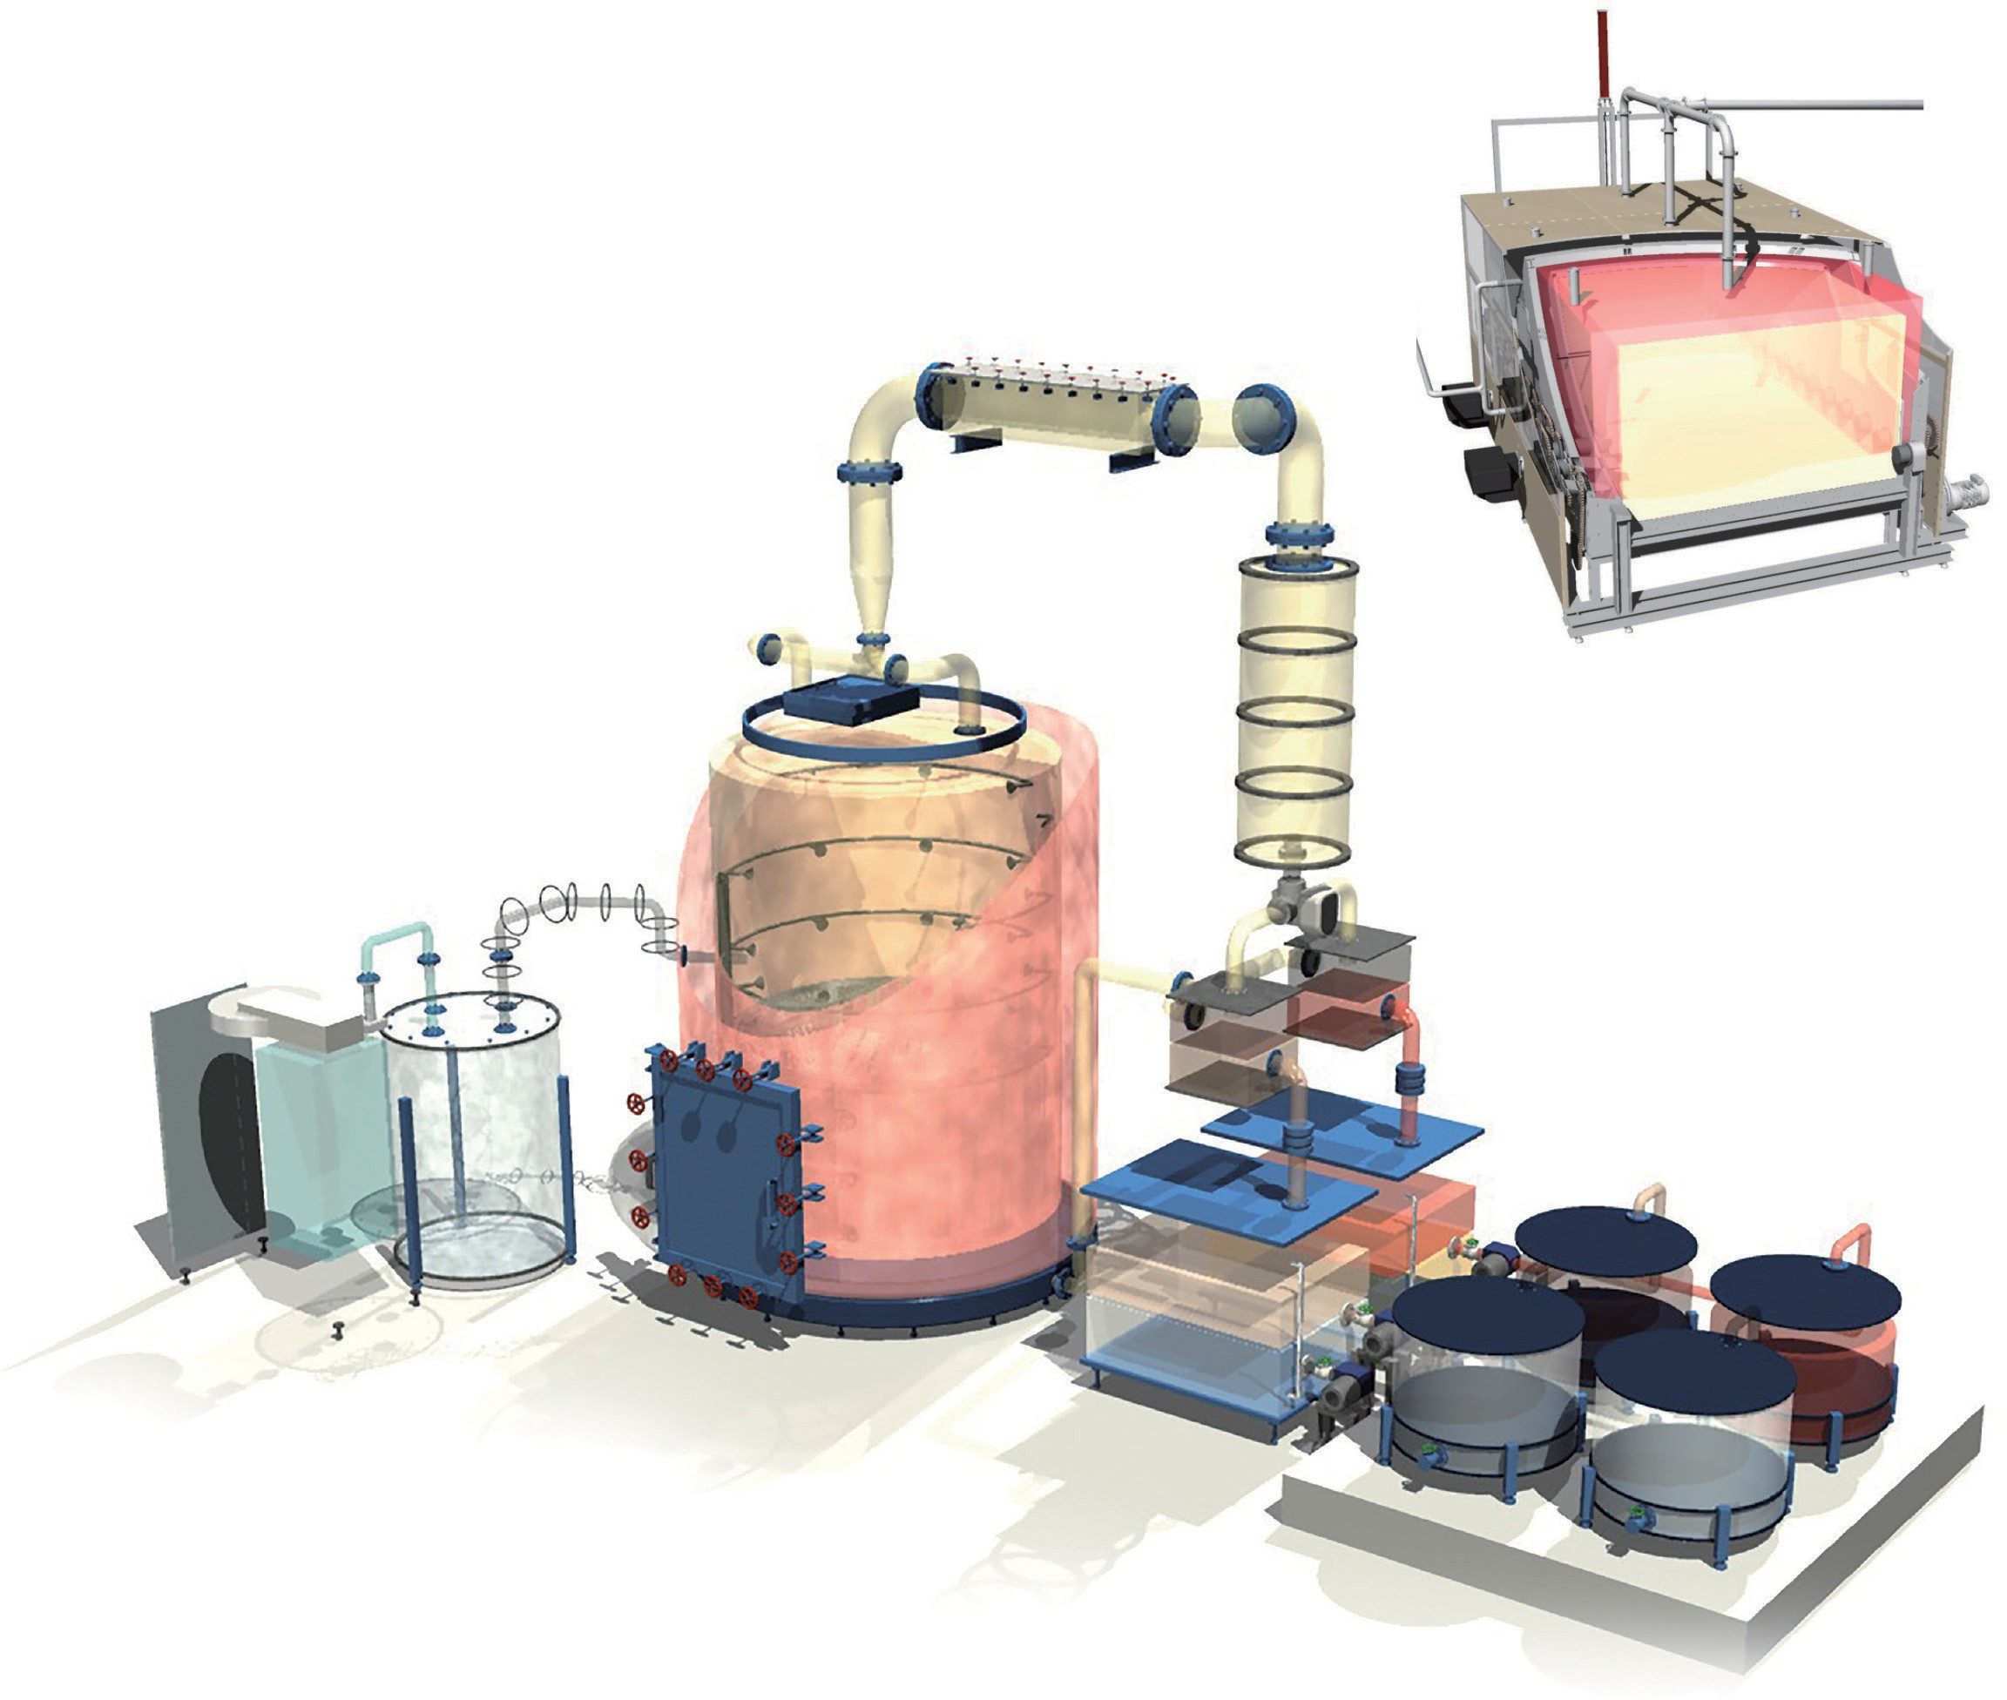








New generation Resource Recovery Equipment
Fuel Recovery Mechanism
«Decomposition furnace»
Fuel Recovery Mechanism is s follows:
Inject high-temperature oxygen-free steam(further superheated) at 600 °C into the cracking furnace.
Distillate and vaporize oil component by high-temperature H₂O gas.
The vaporized gas is treated with chlorine catalyst and liquefied by a cooling condenser.
Segregate gas-oil and heavy-oil by the temperature difference of vaporized gas through a solenoid valve.
Water is separated in an oil/water separation tank, remove impurities in a filtration tank, and recover recycled oil.
Temperature approx. 600 °C
«Superheat layer»
«Catalytic layer»
Chlorine adsorption treatment
OFF GAS
II ^{Superheated steam potential}
Dioxin & carbon dioxide free
The inside of the reactor is anoxic, and no oxygen reaction occurs. Therefore, Dioxin and CO₂ are not generated.
Superheated steam carbonization furnace
Dioxin does not occur !
«Decomposition furnace» Volume approx. 14 m³ Temperature approx. 600 °C
Continuous reaction system
«Condenser» Vaporized gas liquefaction
In the continuous process type, the single batch type structures are installed at 7 or 4 places with the specifications suitable for the purpose.
⬆⬆⬆⬆⬆⬆
Distillated vaporization
«General purpose boiler»
«Solenoid valve»
C
«Drain pot»
H²O
Water
Compound
Carbon
CL
Carbon
Reducing atmosphere, anoxia
H
Chlorine
OFF GAS
«Heavy fuel oil/separation tank»
Hydrogen
«Oil filtration tank»
Conventional incinerator / carbonizing furnace
C
Dioxin generation !
«Superheated steam generator»
O²
Carbon
CL
^{CO}2
«Gas(diesel) oil separation tank»
Oxygen
H
Chlorine
Hydrogen
Image : URB-50 / Batch 5Mt
Heating power of superheated steam
Water becomes steam when it reaches 100°C. At this time, the steam tempera- ture is 100°C.
Through further rubbing the molecules at high speed, the temperature of the steam exceeds 100°C, and it becomes colorless and transparent H₂O gas.
This gas has the characteristics of spread heat transfer, convective heat trans- fer, and condensation heat transfer. It holds the combined heat transfer power of oxygen, convection, radiation, condensation with accurate controllability.
Oil recovery system
«Water filtration tank»
purpose boiler
max. 165℃
Decomposition
furnace
Catalytic layer
Condenser
Superheated steam generator
max. 600℃
Distillated vaporization
Drain pot
Carbon
OFF GAS
Oil separation
Oil filtration tank
Oil tank
Heating burner
tank
833kcal/s
▶▶▶
Page 14
※ Copyright Oneworld Ccorprration. + ART, All r ights reser ved.

Slide 15










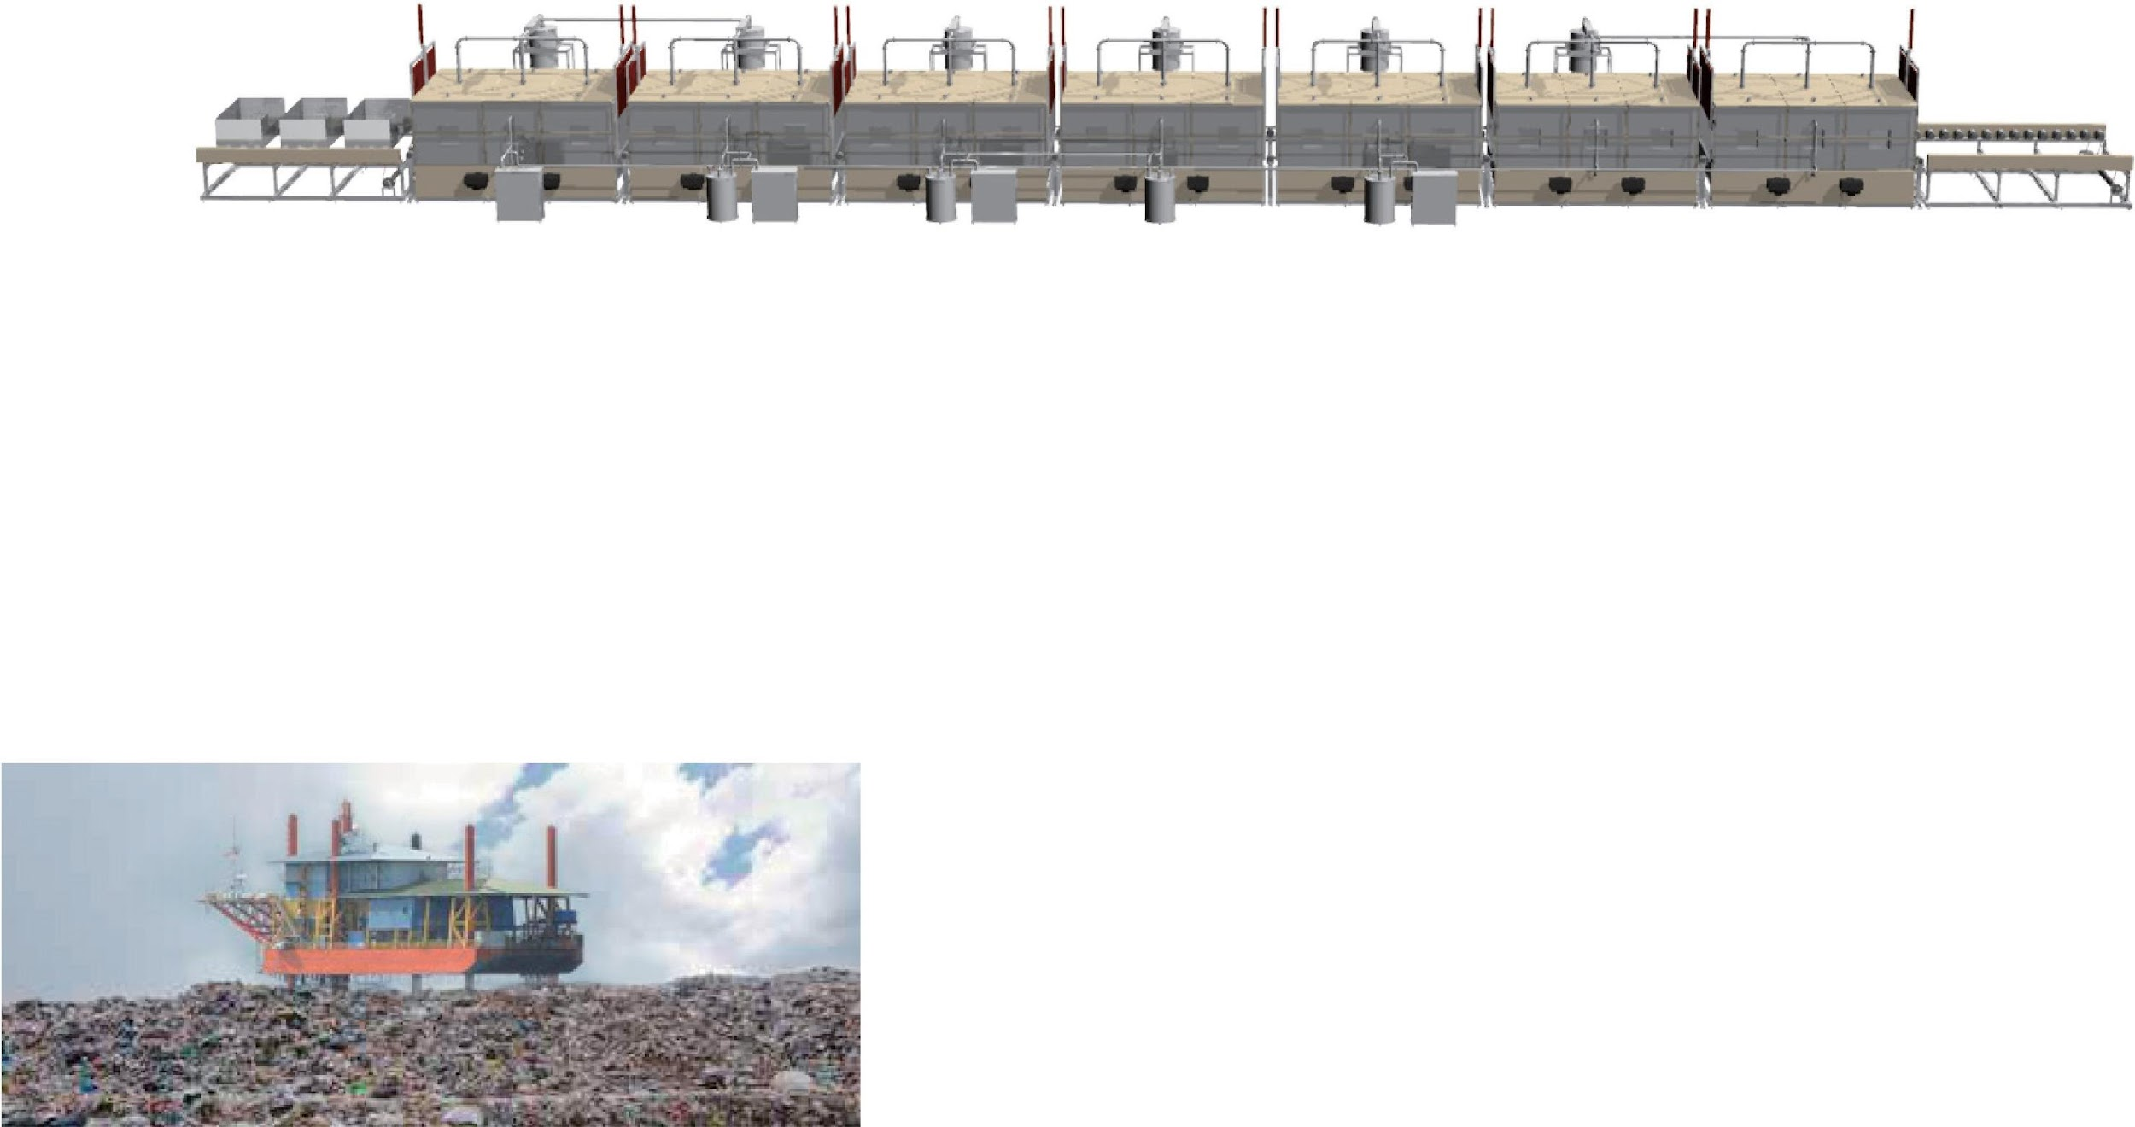
EXPLANATION
II overheat temperature of 7-continuous process unit
GET
GET GET
Heating Oil Gas (Diesel) Oil Heavy Oil
GET
Asphaltenes
HEATING ZONE
150℃ 300℃ 450℃
3 bucket movement in 90 minutes
COOLING ZONE
600℃ 400℃ 150℃
24 hours throughput: 17 units 51 buckets
60℃
Input
Outlet
90 min.
<1.5h>
180 min.
<3h>
270 min.
<4.5h>
360 min.
<6h>
450 min.
<7.5h>
540 min.
<9h>
630 min.
<10.5h>
New generation Resource Recovery Facility
Continuous unit system
The continuous unit process has a temperature setting for each unit. The state of the extracted vaporized gas is stable by a constant temperature setting and able to create the environment for chlorine removal, liquefaction, and cooling process without time lag and loss. It is possible to carry out the work efficiently and accurately for the work before loading and the residuals processing such as carbides and metals.
II 7 - continuous process bucket timetable 7-continuous process bucket timetable : |  |  |  |  |  |  |  |  |  | 7-continuous process, 90 minutes
ENT | 1 | 2 | 3 | 4 | 5 | 6 | 7 | OUT |  | Offloading time
○①○
○②○ | ○①○ |  |  |  |  |  |  | Start-up loss (no off-loading)
○③○ | ○②○ | ○①○
○④○ | ○③○ | ○②○ | ○①○
○⑤○ | ○④○ | ○③○ | ○②○ | ○①○
○⑥○ | ○⑤○ | ○④○ | ○③○ | ○②○ | ○①○
○⑦○ | ○⑥○ | ○⑤○ | ○④○ | ○③○ | ○②○ | ○①○
○⑧○ | ○⑦○ | ○⑥○ | ○⑤○ | ○④○ | ○③○ | ○②○ | ○①○
○⑨○ | ○⑧○ | ○⑦○ | ○⑥○ | ○⑤○ | ○④○ | ○③○ | ○②○ | ○①○ |  | 0h.
○⑩○ | ○⑨○ | ○⑧○ | ○⑦○ | ○⑥○ | ○⑤○ | ○④○ | ○③○ | ○②○
○⑪○ | ○⑩○ | ○⑨○ | ○⑧○ | ○⑦○ | ○⑥○ | ○⑤○ | ○④○ | ○③○
○⑫○ | ○⑪○ | ○⑩○ | ○⑨○ | ○⑧○ | ○⑦○ | ○⑥○ | ○⑤○ | ○④○
○⑬○ | ○⑫○ | ○⑪○ | ○⑩○ | ○⑨○ | ○⑧○ | ○⑦○ | ○⑥○ | ○⑤○ |  | 6h.
○⑭○ | ○⑬○ | ○⑫○ | ○⑪○ | ○⑩○ | ○⑨○ | ○⑧○ | ○⑦○ | ○⑥○
○⑮○ | ○⑭○ | ○⑬○ | ○⑫○ | ○⑪○ | ○⑩○ | ○⑨○ | ○⑧○ | ○⑦○
○⑯○ | ○⑮○ | ○⑭○ | ○⑬○ | ○⑫○ | ○⑪○ | ○⑩○ | ○⑨○ | ○⑧○
○⑰○ | ○⑯○ | ○⑮○ | ○⑭○ | ○⑬○ | ○⑫○ | ○⑪○ | ○⑩○ | ○⑨○ |  | 12h.
○⑱○ | ○⑰○ | ○⑯○ | ○⑮○ | ○⑭○ | ○⑬○ | ○⑫○ | ○⑪○ | ○⑩○
○⑲○ | ○⑱○ | ○⑰○ | ○⑯○ | ○⑮○ | ○⑭○ | ○⑬○ | ○⑫○ | ○⑪○
○⑳○ | ○⑲○ | ○⑱○ | ○⑰○ | ○⑯○ | ○⑮○ | ○⑭○ | ○⑬○ | ○⑫○
○㉑○ | ○⑳○ | ○⑲○ | ○⑱○ | ○⑰○ | ○⑯○ | ○⑮○ | ○⑭○ | ○⑬○ |  | 18h.
○㉒○ | ○㉑○ | ○⑳○ | ○⑲○ | ○⑱○ | ○⑰○ | ○⑯○ | ○⑮○ | ○⑭○
○㉓○ | ○㉒○ | ○㉑○ | ○⑳○ | ○⑲○ | ○⑱○ | ○⑰○ | ○⑯○ | ○⑮○
○㉔○ | ○㉓○ | ○㉒○ | ○㉑○ | ○⑳○ | ○⑲○ | ○⑱○ | ○⑰○ | ○⑯○
○㉕○ | ○㉔○ | ○㉓○ | ○㉒○ | ○㉑○ | ○⑳○ | ○⑲○ | ○⑱○ | ○⑰○ |  | 24h.
○㉖○ | ○㉕○ | ○㉔○ | ○㉓○ | ○㉒○ | ○㉑○ | ○⑳○ | ○⑲○ | ○⑱○
※ The facility image may be different from the real one. It is an image based on the ideal basic design Page 15

Slide 16

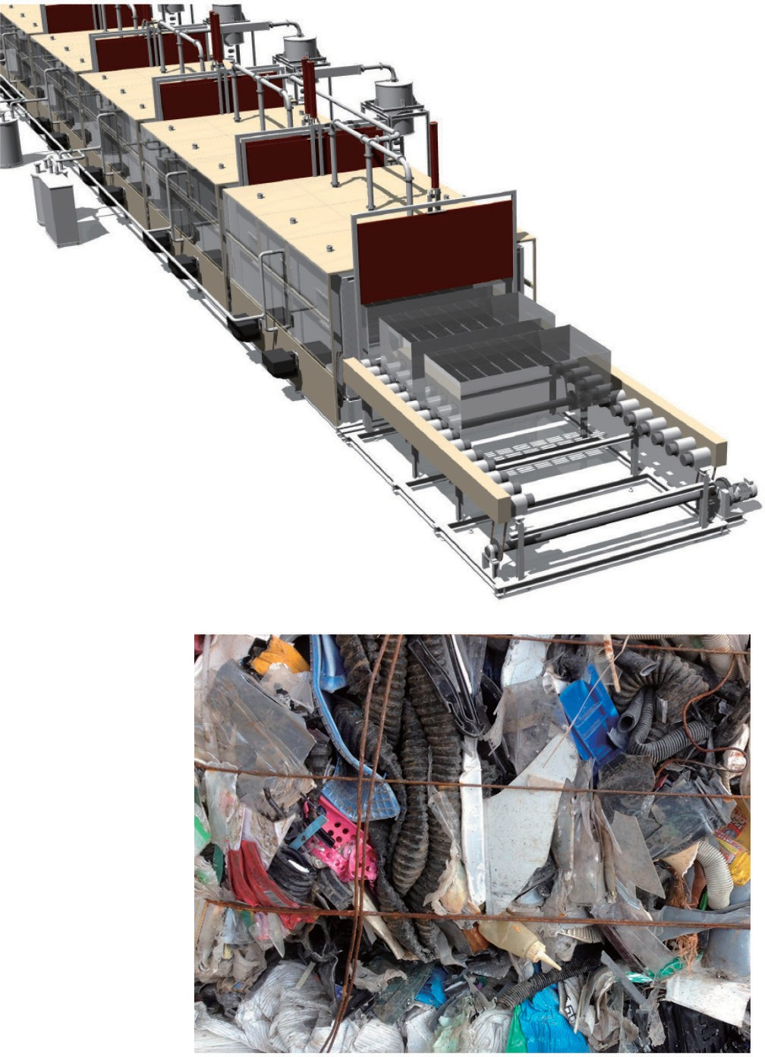








New generation Resource Recovery Facility
About inputs and recovery fuel oil
II Details of waste per day that can be recovered by URC-2000
URBAN RIG is a new generation resource recycling facility that can easily recover fuel oil from waste by thermal decomposition without pre-treatment and sorting. The carbonization reduction rate of waste is up to 5%, and the fuel oil ^{recovery from} resin-based waste is about 85% of the input content.
Ingredient Component Daily Recovery name ratio quantity
Resource recycling method
 | Gas (Diesel) Oil | 61.2 % | 62,424ℓ (62.424ton) | Reuse in the processing machine = 1500ℓ Fuel for sale = 60,924ℓ Electricity sales = 60,924ℓ
o
 | Heating Oil | 7.65 % | 7,803ℓ (7.803ton) | Sale as heating fuel
 | Heavy Oil | 7.65 % | 7,803ℓ (7.803ton) | Sale as heating fuel
 | Recovery Loss | 11.5 % | 11,730ℓ (11.73ton) | Mainly discharged as flue gas; a very small amount will be carbide.
Carbide |  | 5 % | 5.1m³ (5.1ton) | Produce high-calorie powder coal mixed with heavy oil
water |  | 5 % | 5,100ℓ (5.1ton) | Reuse in steam boiler. Residual water is utilized as in house water or drain to sewage.
Metals and glasses etc. |  | 2 % | 2.04m³ (2.04ton) | Metals and glasses = Recycled resources Debris sand, stone = Reclamation at site
i l
L iq u e f ie d
Amount of input "one day"
200^{Mt}
gravity : 0.6
Specific
Image : URC-2000
Resin content rate _{90%}
90%
Sample input Resin content rate of 90% (unwashed) Poly-based and PVC-based vinyl mixed
other, bound iron wire, adherence, etc.
※ PVC: 10% Poly: 80% etc
Resin content rate
If the component ratio of the input waste is the same, the same recovery ratio can be achievable with any model
Page 16
※ Copyright Oneworld Ccorprration. + ART, All r ights reser ved.

Slide 17
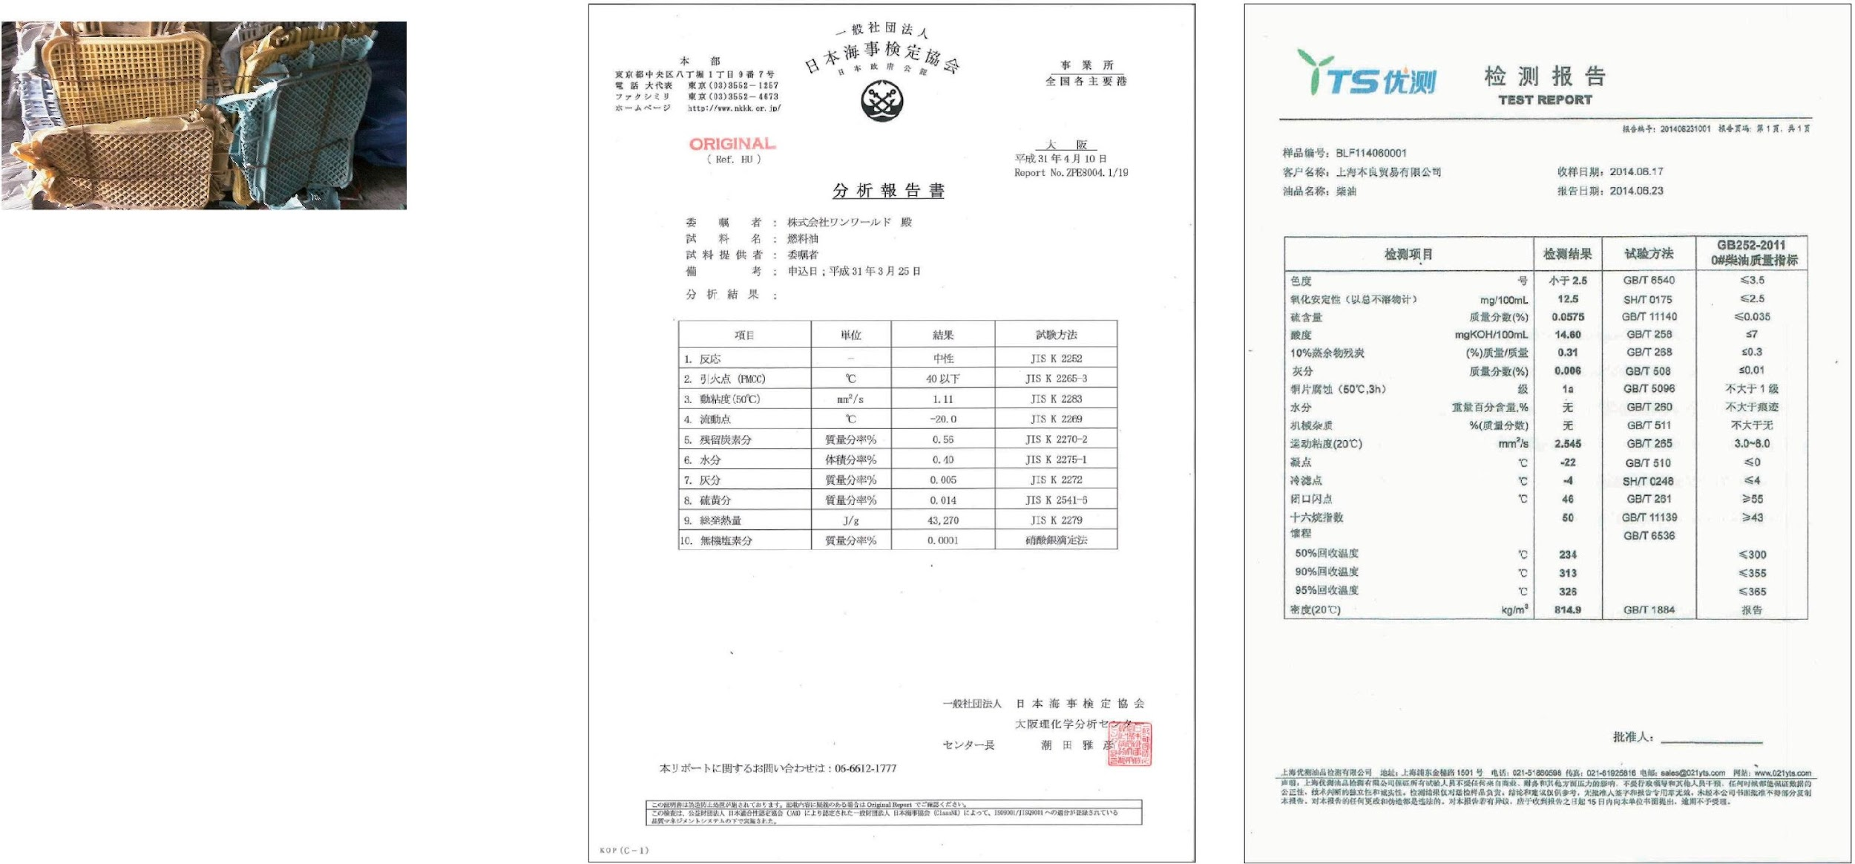

EXPLANATION
New generation Resource Recovery Facility
Quality of recovery fuel
90%
Resin content rate
Sample input Resin content rate of 90% (unwashed) Poly-based and PVC-based vinyl mixed other, bound iron wire, adherence, etc.
※ PVC: 15% Poly: 80% etc
 |  | D ie s e l ( g a s ) oi l c om p on e n t
Diesel(gas) oil component (Flashpoint range) |  |  | 1st. 21°^{under} | 2nd. 21-70° | 3rd. ⁷⁰⁻²⁰⁰° |  | 4tj. ²⁰⁰⁻²⁵⁰°
1 | Flashpoint |  |  | 46°
2 | Dynamic viscosity |  |  | 2.28
3 | Pour point |  |  | - 4°
4 | Pour point |  | - | - 22°
5 | Residual carbon content |  |  | 0.31
6 | Ash Content |  | 0.05 ^{under} | 0.006
7 | Total chlorine content |  | 100 ^{under}
8 | Sulfur content |  | 0.2 ^{under}
9 | Nitrogen content |  | 0.2 ^{under}
10 | moisture |  | Does not contain free water
11 | Cetane index
About Recycled Fuel
The recovery fuel oil component varies depending on the content of the resin waste to feed. To recover the appropriate component value of fuel oil, it is necessary to control system settings such as overheat temperature and time.
Field report
At a processing plant in China (Shandong Qufu), the recovered diesel oil is used as forklift fuel.
<Drum batch type 5 tons>
※ The facility image may be different from the real one. It is an image based on the ideal basic design Page 17

Slide 18
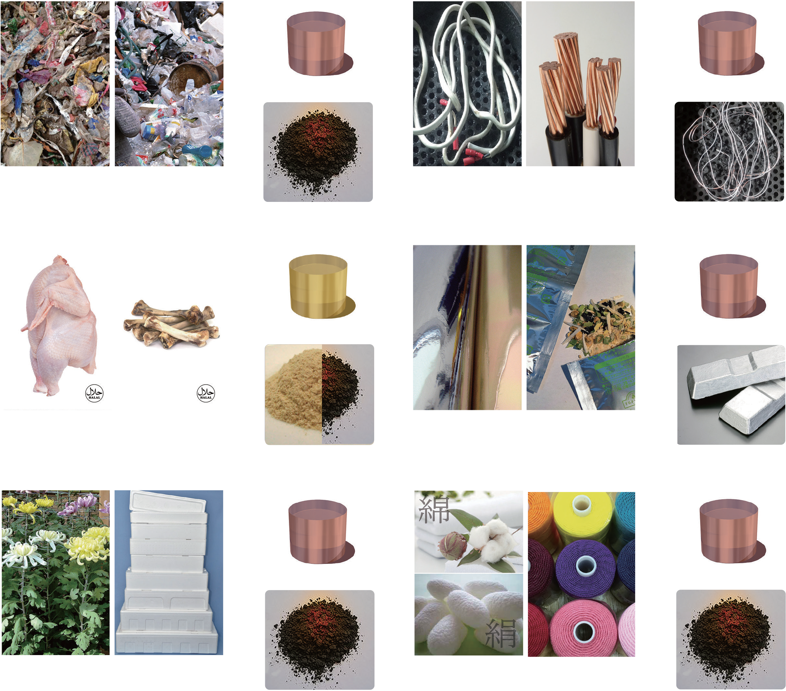
New generation Resource Recovery Facility
About Waste
General household waste
Wire cord waste
Not disposable Wastes can treat with zero fuel consumption.
The right pictures are for reference only. Waste treatment laws and regulation are differ de- pending on the country or region. Also, the recovery rate and the recovery material com- ponent may change depending on the waste. Please contact us for a suitable system.
Mineral oil
Mineral oil
Garbage waste paper scrap wood 85% 〜 95%
scrap wood 15% 〜 5%
Charcoal (carbide)
Vinyl resin 80% 〜 65%
Copper wire 35% 〜 20%
Copper (No oxidation)
Livestock waste
Deposition films wastes
Request for preliminary analysis of waste
OneWorld analyzes carbonization volume reduction and analytic survey of fuel oil recovery rate and other recovery items other than fuel oil (aromatics, etc.) for the waste trouble you with a reasonable fee. Also, based on these analyses, we can propose a basic planning system based on the processing volume required
Animal drainage & oil
Mineral oil
Raw meat, Internal 75% 〜 85%
Bone, teeth, nails 25% 〜 15%
Calcium / Carbide
Aluminum / PE 35% 〜 25%
Resin series 75% 〜 65%
Alumimum
Flower wastes
Textile waste
Contact us
oneworld-jp.co/contact
Please contact us by specifying the waste you want to analyze together with an overview of your company. We will send an analysis survey request form. We will inform you of the analysis costs as well.
Mineral oil
Mineral oil
Fresh flowers 70% 〜 80%
Packaging materials 30% 〜 20%
Charcoal (carbide)
Natural fiber 35% 〜 30%
Chemical fiber 70% 〜 65%
Charcoal (carbide)
Page 18
※ Copyright Oneworld Ccorprration. + ART, All r ights reser ved.

Slide 19

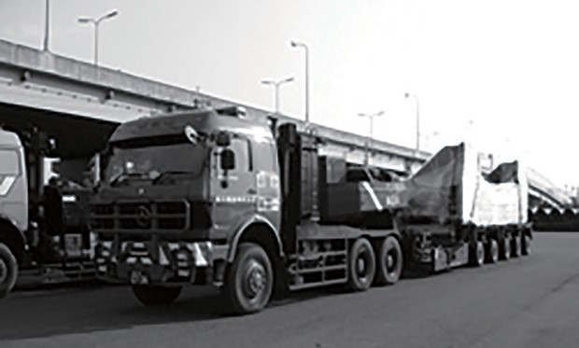
EXPLANATION
New generation Resource Recovery Facility
Progress schedule
The manufacturing period varies depending on the product. Continuous type = about 10 months · Batch type = about 6 months
Day
Contracted Period
Start Manufacturing period
Delivery and adjustment period
Item
Negotiation
Agreement
Payment
▼
Start design
Manufacturing
Completed
Test
Packin
payment
run
▼
▼
Presentation of required documents such as
Shipment
Land trasport
Assembly
Test run Adjustment
Completion
Content of work for each party
Introduction of Product discription. Description of Made ro order.
Seller ^{Contents of contract.}
Location for instract.
Base design.
Report on the end of production
Report on the end of
of trial oderation
Application for processing lisense to responsible regional administraction
Customs receipts & Trsndportstion arrangements
Preparation for water and fuel
Preparation Oil recovery for general Extraction test
waste arrengement
Disclosure of the instsllstion site. Description of Purchased Corporation.
Remittance Instruction
Buyer
F oundation regional work of setting constraction. P reparation of w ater s upply and waste liqui d treatment equipment.
Examination and preparation for charcoa l
The standards, application procedures, qualification criteria, etc. differ depending on the country and region. If you plan to introduce our facility, please consult with the relevant authorities in advance.
The foundation basic strength of the ground requires a foundation curing of 5 Mt or more per square meter.
The processing unit will be loaded on a large trailer.
Please follow the guidance of the relevant authorities for drainage and exhaust conditions.
※ The facility image may be different from the real one. It is an image based on the ideal basic design Page 19

Slide 20



OneWorld corporation
株式会社ワンワールド
〒 547-0016 大阪市平野区長吉長原 1-1-20電話: 06-4392-7499 FAX : 06-4392-7676
URL : www.1-world.asia Mail: info@1-world.asia
Oneworld Corporation
1-1-20 Nagayoshinagahara, Hirano-ku, Osaka, Japan Tel: 08-6-4392-7499 FAX : 08-6-4392-7676
URL: www.1-world.asia Mail: info@1-world.asia
Copyright ONE WORLD + ART, All r ights reser ved.

